Slide 1
The package
Based on a true story….

Slide 2

Here, this is
for you!
Oh, yay! For my
birthday? Let me see!

Slide 3
Oh! Wait! Don’t…
What?

Slide 4
…open it..

Slide 5

…it’s a
DATA package.
A data
package?

Slide 8
Notes:
https://ooshybooshy.com/diy-newspaper-gift-wrap/

Slide 9

How can we [really] humanize data packages?
Notes:
How can we make our data packages become currency in the realm of impact? How can we leverage the exchange of technical information to build long-term relationships with communities other than scientists?

Slide 10
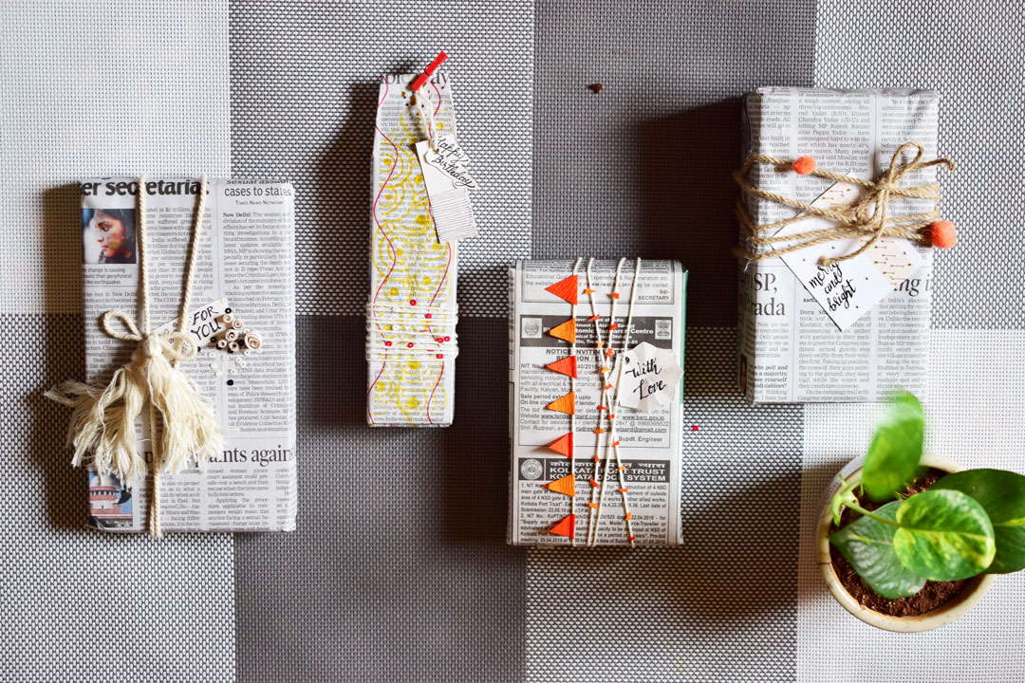
https://ooshybooshy.com/diy-newspaper-gift-wrap/
Story-wrappers
Notes:
We are talking about stories about the data and stories that could be told from the data. We are not talking about developing data stories or changing the data packages format.

Slide 11

How to tell inclusive stories about data?

Slide 12
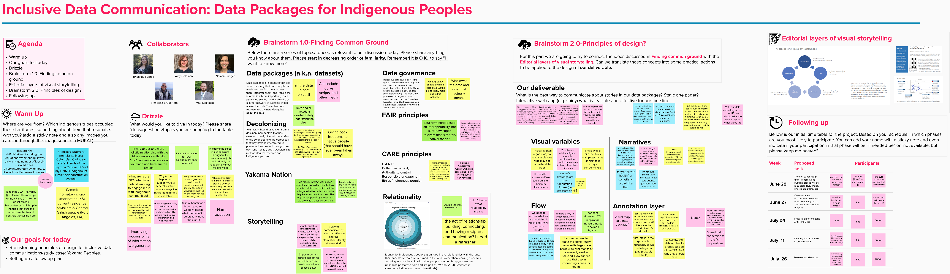

Slide 13
Visual Storytelling Design
Visualizations
Flow
Narration
Words & Pictures
Interactivity
Decolonization
F.A.I.R.
data
C.A.R.E. Principles
Relationality
Editorial layers for
Visual Storytelling
(Modified from Bach et al., 2017)

Slide 16
The end…

Slide 17

?
?
?
?
?
?
?
…Or perhaps you have questions….

